Slide 1
Welcome!
Markman Lab
Department of Psychology
Stanford University
Notes:
Hello, (child) and (parent/guardian)! My name is ____. It’s really nice to meet you!
Rapport with child if needed: Have you played a game on Zoom before? how is your day? Talk about their shirt, etc…

Slide 2

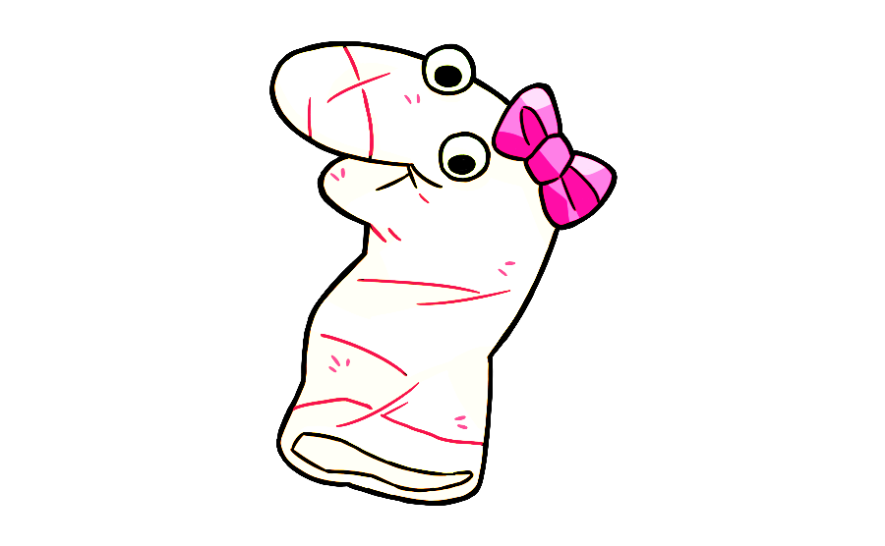


What We’re Doing Today
7 minutes
Help Maggie Learn Puppet Language!
What does your child think?
This session will be recorded.
Notes:
Before we start, I’ll tell you a little bit about what we’re doing today. All together, it will take about 7 minutes to help my friend Maggie learn puppet language. You and Maggie are going to look at pictures together and ask you some questions so you can help her speak puppet language.Aand I just want to know what you think. There aren’t any right or wrong answers, so just tell me what you think ! I’ll be recording the session so I can remember all the things that you tell me – is it ok if I start the recording now?
Ok – I’m going to click the button, and there will be a funny robot voice telling you “This session will be recorded.”
Now we’re ready to start!

Slide 3
Verbal consent
Today’s date is [date].
My name is _____________.
I give consent for my child, _________, to participate in this study.
I understand that I or my child may stop participation at any time.
The IRB determined that the permission of one parent is sufficient for research to be conducted under 45 CFR 46.404, in accordance with 45 CFR 46.408(b).
Notes:
In the scheduling email you received information about our research. Do you have any questions about the activities before you provide your consent to participate?
Great, if you could read the bullet point text aloud.

Slide 4
Step 0: Device and screen size?
Step 1: Are you in full-screen mode?
Yes
No
Notes:
Alright, thank you so much! Now, before we start our game, we have to make sure that the game is going to show up right on your screen.
Can you tell me what device you’re using, and what the approximate screen size is? (Screen size = diagonal.) Great, we’re just asking to help us understand what devices best work with our activities, since we just started online research.
[IF NO]: okay! Could you please enter full screen mode by pressing this button on Zoom?

Slide 5
Please enter full screen mode.
Click the full screen icon:
Notes:
okay! Could you please enter full screen mode by pressing this button?
If you could move your mouse over to the top right of the screen, you should see an icon that looks like this square. Please click on it to enter full screen mode.
If you do not see this icon, that means you’re already in full screen mode.

Slide 6
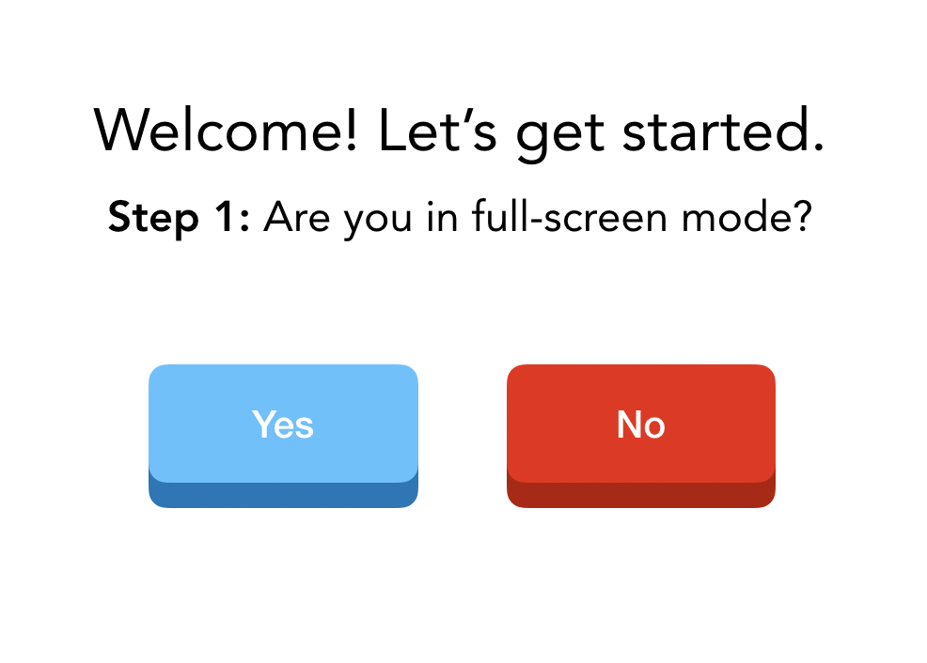
Step 2: Do you see our videos floating on top of the slides or anchored beside the slides?
On top
Beside
(you can click and drag our videos)
Notes:
Do you see our videos floating on top of the slides, or anchored beside the slides? A good way to check is if you can click and drag the videos, our videos are on top of the slides.
[If parent is using external monitor:] We’d like to set up your screen so that my video floats on top of the slides. If you’re viewing my video and the slides on separate monitors, would it be okay to disconnect the monitor for now?

Slide 7
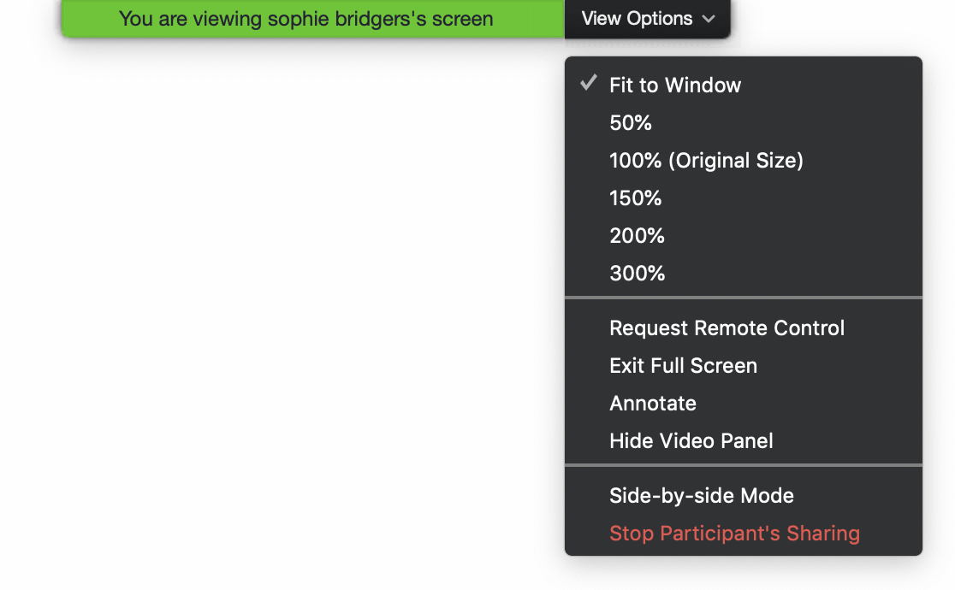
Side-by-side Mode should be unchecked →
You should see our videos floating on top of this slide.
Notes:
Please move your mouse to the top of the screen and select “View Options,” like in this diagram. You should see an option called “Side-by-side Mode” near the bottom—please make sure that it’s unchecked.

Slide 8
Step 3: Can you see both of our videos on the screen, or just the researcher?
Just researcher
Both videos
Notes:
Can you see both of our videos, or just me?

Slide 9
Move your mouse over the upper right corner of your video.
Hover over the blue and white ellipsis.
Select Hide Self View from the dropdown menu that appears.
…
Notes:
If you move your mouse over your own video, you will see a blue square with an ellipsis. Please click on that, and then click ‘Hide Self View’.
Do you just see my video now?
[If “yes”: Skip to slide 14]
[If there are other people on the call, the parent might still be able to see their icons:] As I mentioned in the beginning of the game, we have a few researcher assistants sitting in. So we’re also going to hide them.

Slide 10
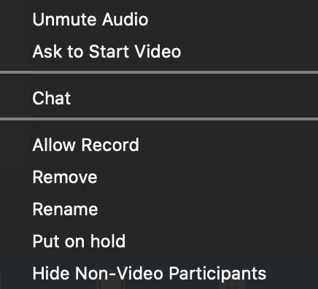
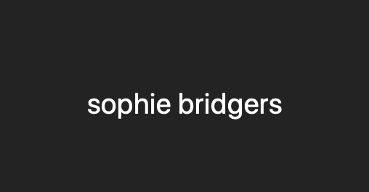
Move your mouse over the upper right corner of the non-video participant.
Hover over the blue and white ellipsis.
Select Hide Non-Video Participants.
…
Notes:
IF OTHERS SHADOWING:
Today we have a few people sitting in on the session for training purposes, is it okay?
Great, let’s hide them out of view. Could you please move your mouse over to any one of the other participants, click the ellipsis icon, and select ‘Hide Non-Video Participants’?
[After they’re done:] So do you see just my video now? Wonderful!

Slide 11
Step 4: Move my video here!
Notes:
Alright. Is my video on the top right side of the screen?
If not, please click and drag it there now.
Ok! We are all set to play the game.

Slide 12

Notes:
Hi my name is David. What is your name? I have a game for you to play today with me. Do you want to play a game? Ok! Once we start the game, I’m going to ask you some questions and I just want to know what you think. There aren’t any right or wrong answers, so just tell me what you think ok. And also, just so you know, if you want to stop the game at any time, you just let me know ok? Alright let’s start the game.

Slide 13
This is my friend Maggie. Say hi to Maggie. She is learning to speak puppet language and needs your help. Would you like to help Maggie learn to speak puppet language?
OK great! Are you ready to help her learn puppet language?

Slide 14
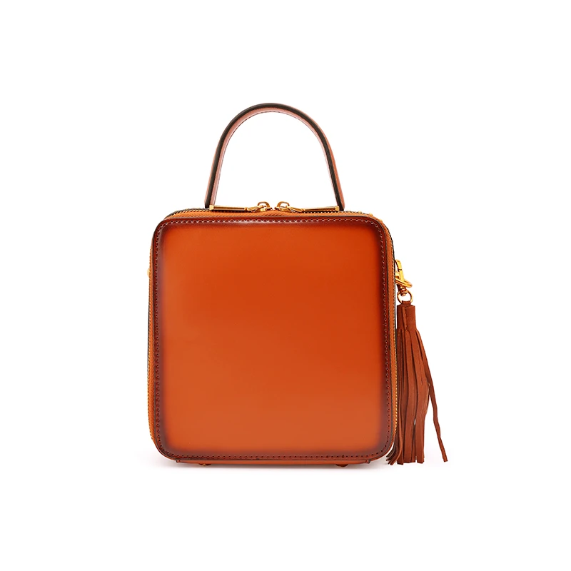
See this? This is a zulu. Zulus are for carrying things in.
Notes:
Click when saying see this—it will wiggle

Slide 15

See this? It is for watching.
Notes:
Click when saying see this—it will wiggle

Slide 16

See this? It is for carrying things in.
Notes:
Click when saying see this—it will wiggle

Slide 17
Notes:
Question: See this zulu (click)? Can you find another zulu? Is it this one on top (click) or this one on bottom (click)?

Slide 18


Thanks for helping Maggie! Let’s help her learn some more puppet language.

Slide 19
See this? This is a mupa. Mupa is for wearing.
Notes:
Click when saying see this—it will wiggle

Slide 20

See this? It is for wearing.
Notes:
Click when saying see this—it will wiggle

Slide 21
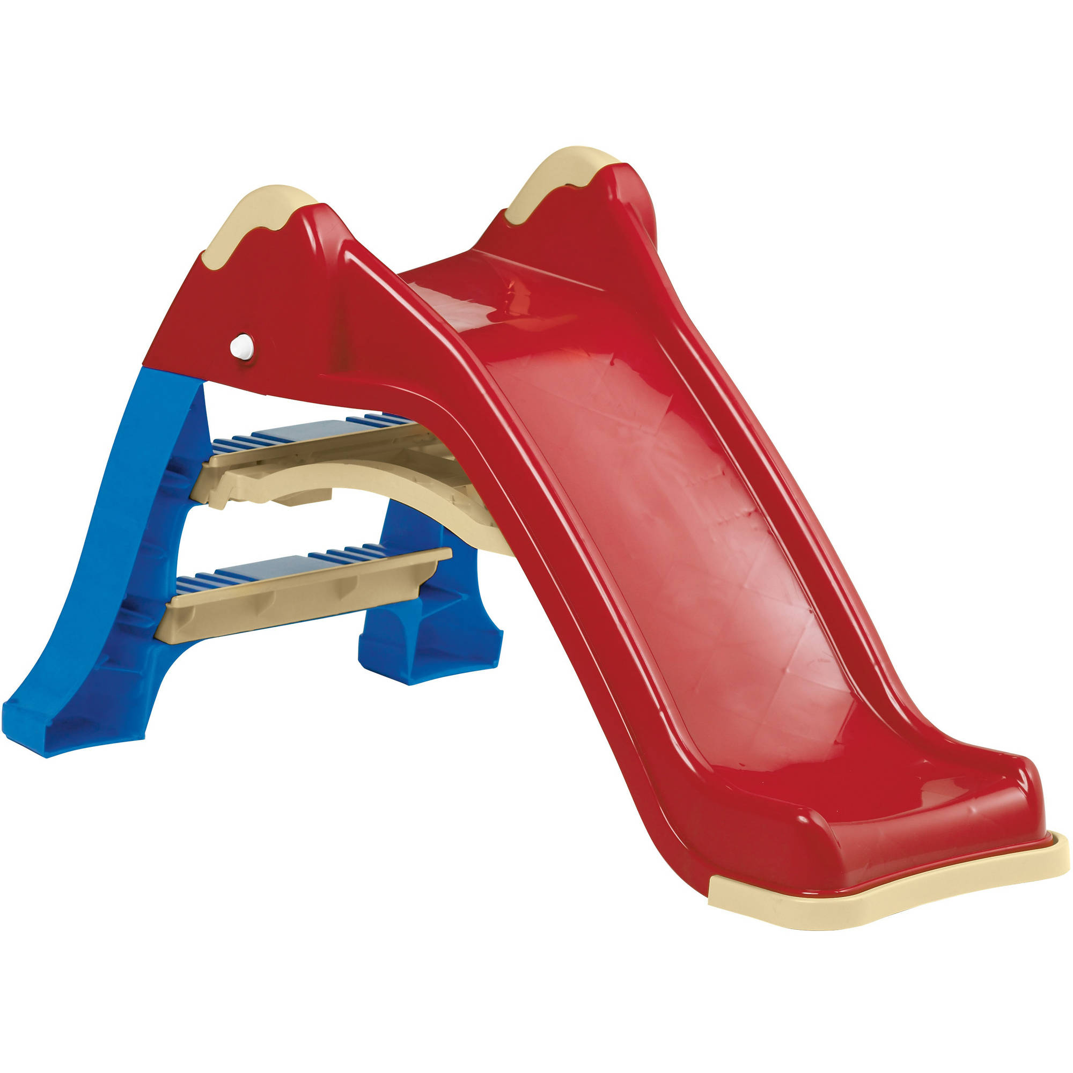
See this? It is for sliding down.
Notes:
Click when saying see this—it will wiggle

Slide 22
Notes:
Question: See this mupa (click)? Can you find another mupa? Is it this one on top (click) or this one on bottom (click)?

Slide 23
Thanks for helping Maggie! Let’s help her learn some more puppet language.

Slide 24
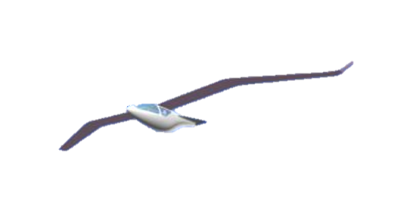
See this? This is a wub. Wubs are for helping people go to different places.
Notes:
Click when saying see this—it will wiggle

Slide 25
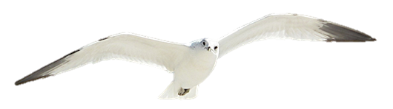
See this? It is for looking at in the zoo.
Notes:
Click when saying see this—it will wiggle

Slide 26

See this? It is for helping people go to different places.
Notes:
Click when saying see this—it will wiggle

Slide 27
Notes:
Question: See this wub (click)? Can you find another wub? Is it this one on top (click) or this one on bottom (click)?

Slide 28
Thanks for helping Maggie! Let’s help her learn some more puppet language.

Slide 29

See this? This is a gerp. Gerp is for growing healthy and strong.
Notes:
Click when saying see this—it will wiggle

Slide 30

See this? It is for playing with at parties.
Notes:
Click when saying see this—it will wiggle

Slide 31
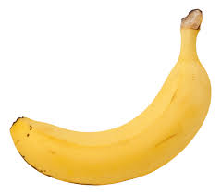
See this? It is for growing healthy and strong.
Notes:
Click when saying see this—it will wiggle

Slide 32
Notes:
Question: See this gerp (click)? Can you find another gerp? Is it this one on top (click) or this one on bottom (click)?

Slide 33
Thanks for helping Maggie! Let’s help her learn some more puppet language.

Slide 34
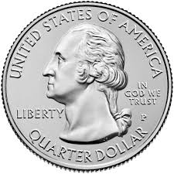
See this? This is bipo. Bipo is for buying things.
Notes:
Click when saying see this—it will wiggle

Slide 35

See this? It is for buying things.
Notes:
Click when saying see this—it will wiggle

Slide 36

See this? It is for eating.
Notes:
Click when saying see this—it will wiggle

Slide 37
Notes:
Question: See this bipo (click)? Can you find another bipo? Is it this one on top (click) or this one on bottom (click)?

Slide 38
Thanks for helping Maggie! Let’s help her learn some more puppet language.

Slide 39

See this? This is a hudi. Hudis are for making air to breathe.
Notes:
Click when saying see this—it will wiggle

Slide 40
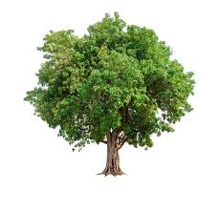
See this? It is for making air to breathe.
Notes:
Click when saying see this—it will wiggle

Slide 41
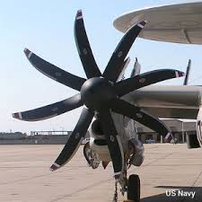
See this? It is for moving things around.
Notes:
Click when saying see this—it will wiggle

Slide 42
Notes:
Question: See this hudi (click)? Can you find another hudi? Is it this one on top (click) or this one on bottom (click)?

Slide 43
Thanks for helping Maggie! Let’s help her learn some more puppet language.

Slide 44
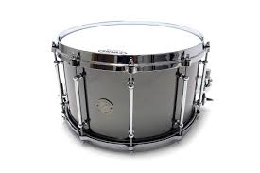
See this? This is an abdy. Abdys are for making music.
Notes:
Click when saying see this—it will wiggle

Slide 45
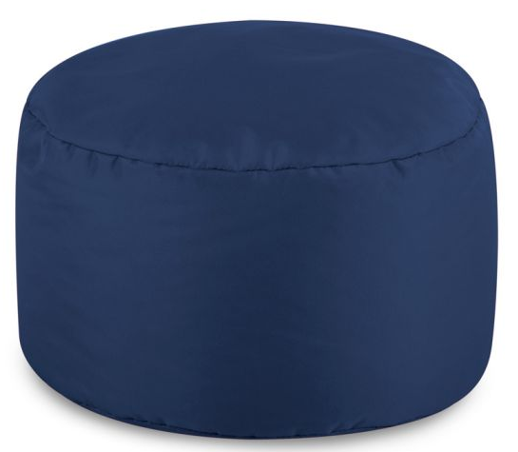
See this? It is for sitting on.
Notes:
Click when saying see this—it will wiggle

Slide 46
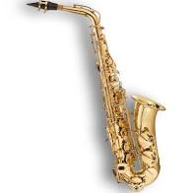
See this? It is for making music.
Notes:
Click when saying see this—it will wiggle

Slide 47
Notes:
Question: See this abdy (click)? Can you find another abdy? Is it this one on top (click) or this one on bottom (click)?

Slide 48
Thanks for helping Maggie! Let’s help her learn some more puppet language.

Slide 49
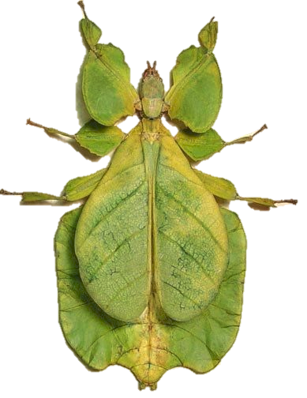
See this? This is an edo. Edos are for biting people.
Notes:
Click when saying see this—it will wiggle

Slide 50
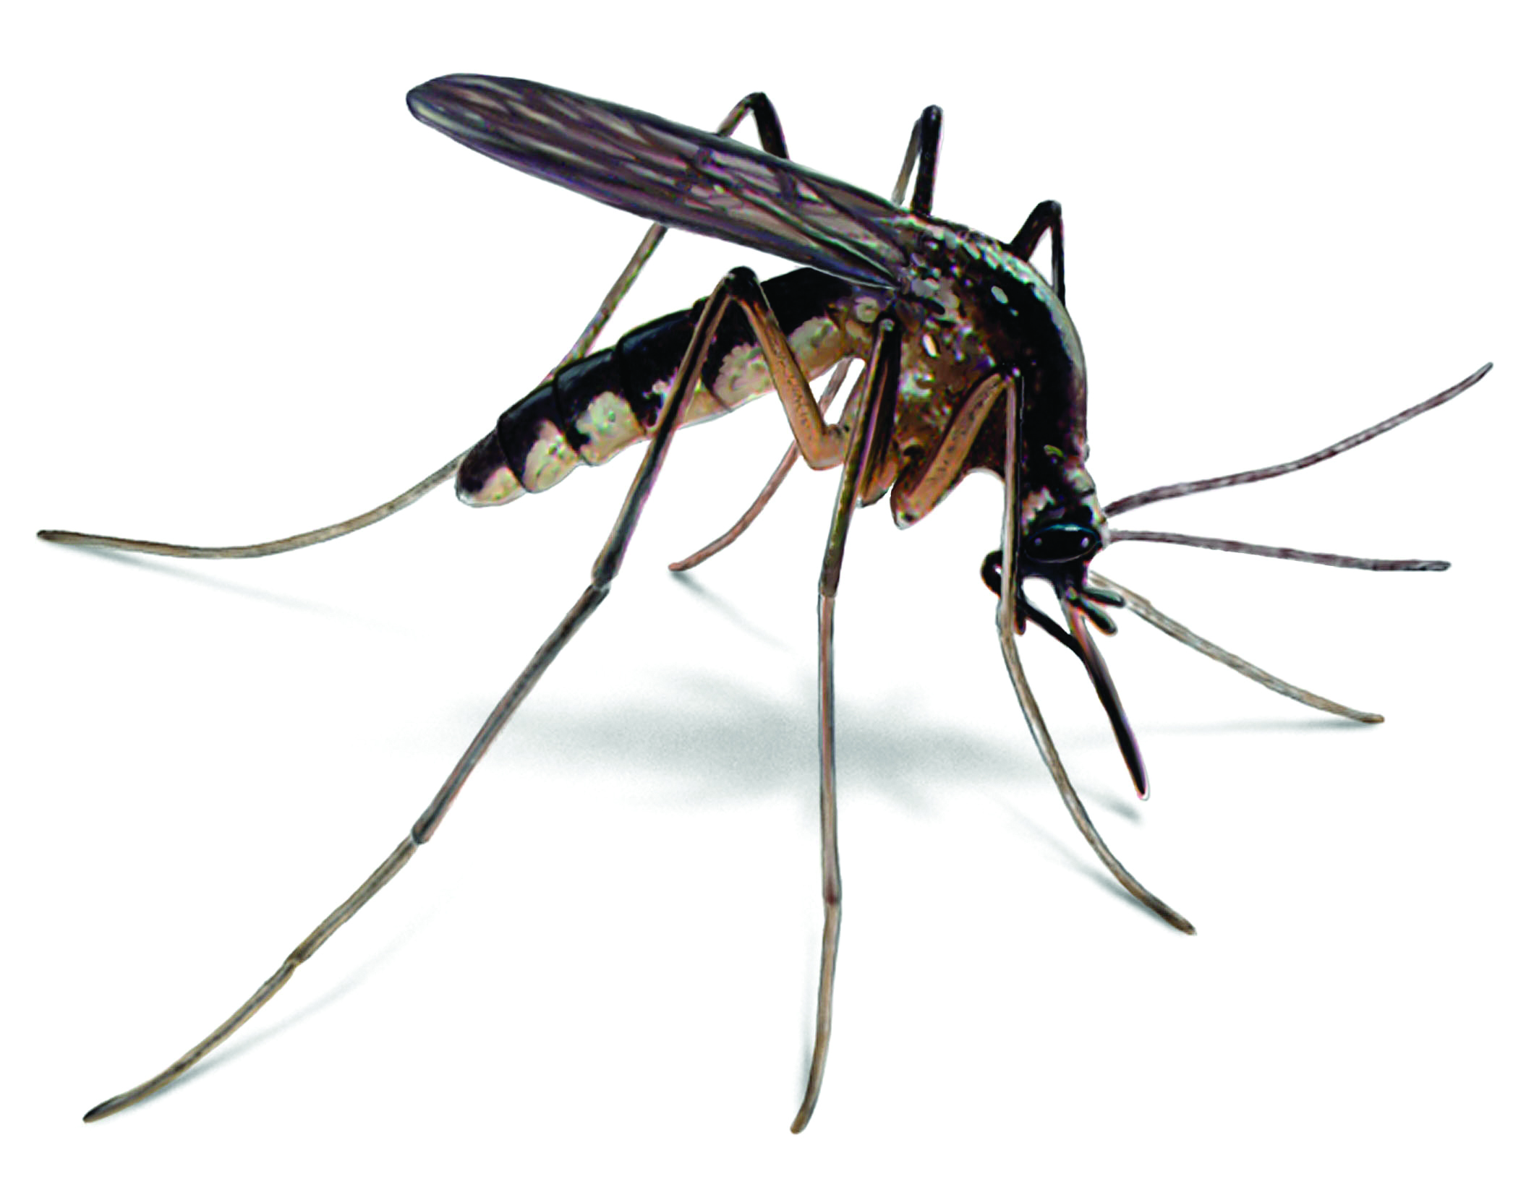
See this? It is for biting people.
Notes:
Click when saying see this—it will wiggle

Slide 51

See this? It is for helping things live.
Notes:
Click when saying see this—it will wiggle

Slide 52
Notes:
Question: See this edo (click)? Can you find another edo? Is it this one on top (click) or this one on bottom (click)?

Slide 53
Thanks for helping Maggie! That’s the end of our game! Can I speak to your parent before we end?
Notes:
Wonderful, thank you so much. First, do you have any questions about our study? (ask parent AND child ). OK so now I have just a couple more questions just to see how things worked for you over zoom.

Slide 54
1. How was the video quality?
1
2
3
4
5
Very poor
Moderate
Very good
Notes:
Next, can you tell me how the video quality was throughout the study, from 1 being the worst and 5 being the best?
Could you see me okay?

Slide 55
2. How was the sound quality?
1
2
3
4
5
Very poor
Moderate
Very good
Notes:
How about the sound quality? Could you hear me okay?

Slide 56
3. How fun was the activity?
1
2
3
4
5
Not very fun
Moderately fun
Very fun
Notes:
And how fun was the activity (for your child)?

Slide 57
Participant Recording Options
Please choose a level of consent option for your child’s video.
1. Research Only
Viewed only by our team.
2. Academic/Educational Use
May be presented as examples at conferences or classes.
3. Public
May be e.g. presented publicly online for public outreach & dissemination of findings.
Notes:
Lastly, how you would like us to use our recording of today’s session? The baseline level of privacy is level 1, research only, which means only the experimenters in our lab will have access to the videos.
I’d be happy to describe the 2 additional levels of privacy if you’re interested - they’re really helpful for us but totally optional. Level 2 allows us to use your child’s video as an example at conferences or classes. Level 3 means your child’s video may be made public. Which level of consent would you be comfortable with?

Slide 58

Expect your child’s $5 gift card to arrive in 1 – 5 business days!
Notes:
That was our last question – thank you so much for taking the time to participate in our study today!

